Slide 1
HMA Marketing Meeting
February 19, 2025

Slide 2
Agenda
Review
Identify Priorities & Schedule
January Email & Website metrics
2024 NNA/AUM graph
Initiatives
Client & Prospect letter
Budget
Ongoing projects
Review Call F/U?
Newsletter, Dusty Money, & ADV Emails going out this week.
Events
March
April
May

Slide 3
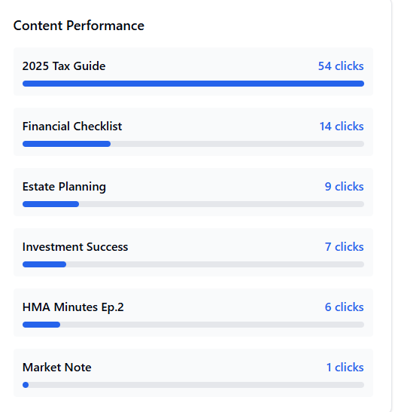
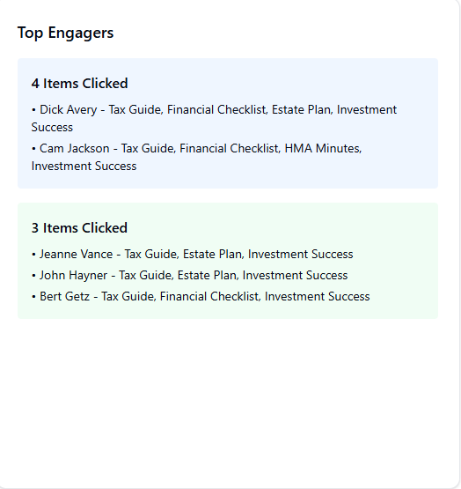
Newsletter Analytics

Slide 4
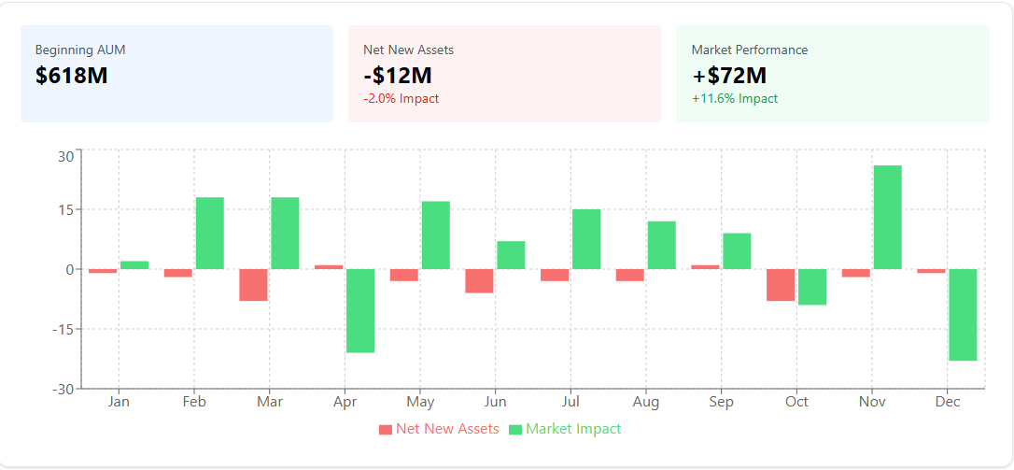
NNA/AUM

Slide 5
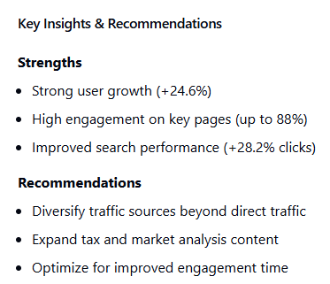
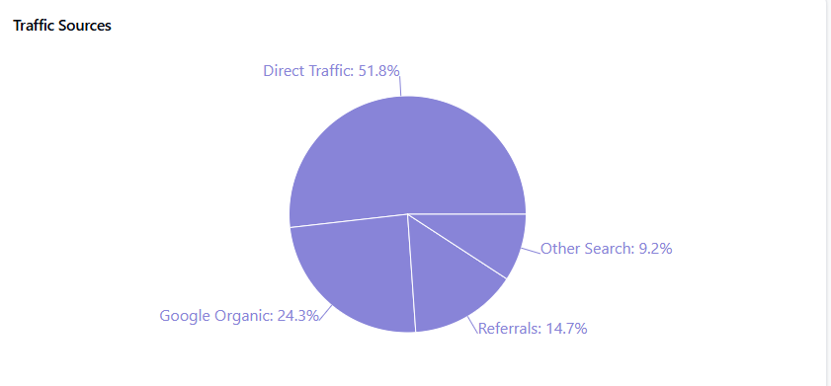
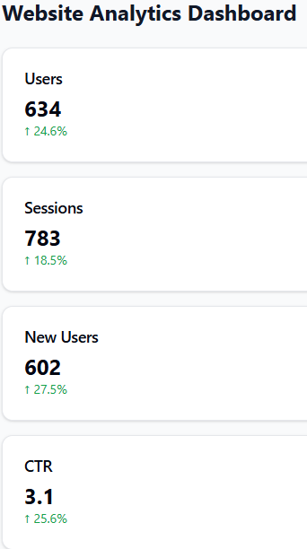
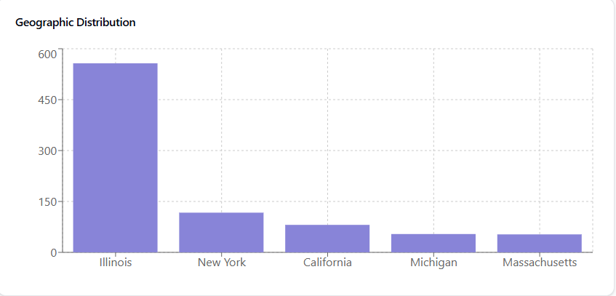
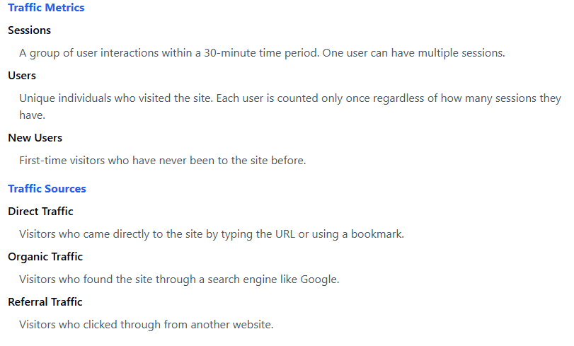
Website Metrics

Slide 6
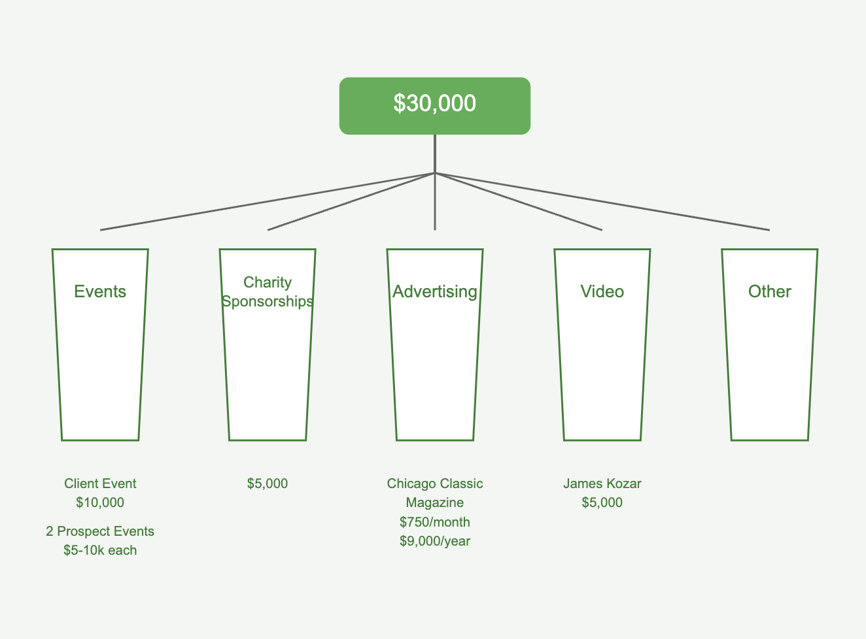
Budget

Slide 7
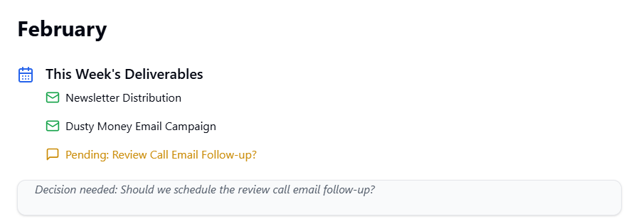

Slide 8
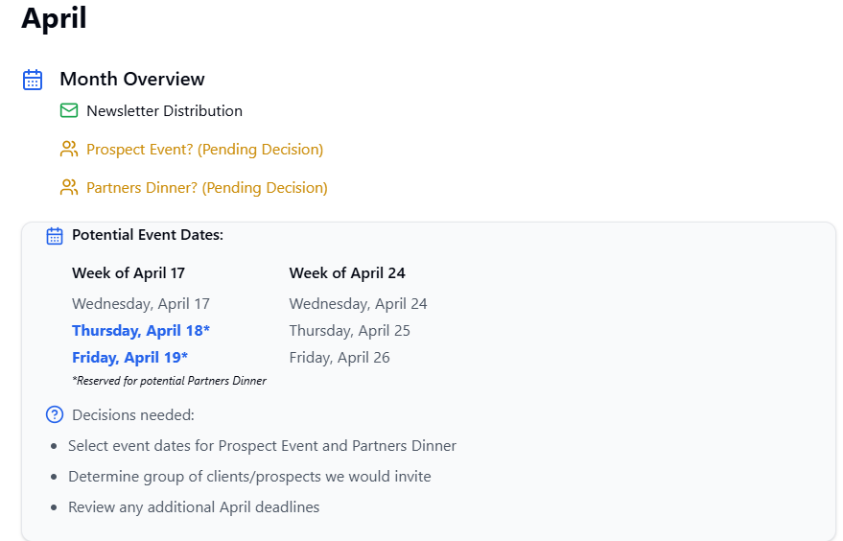

Slide 9
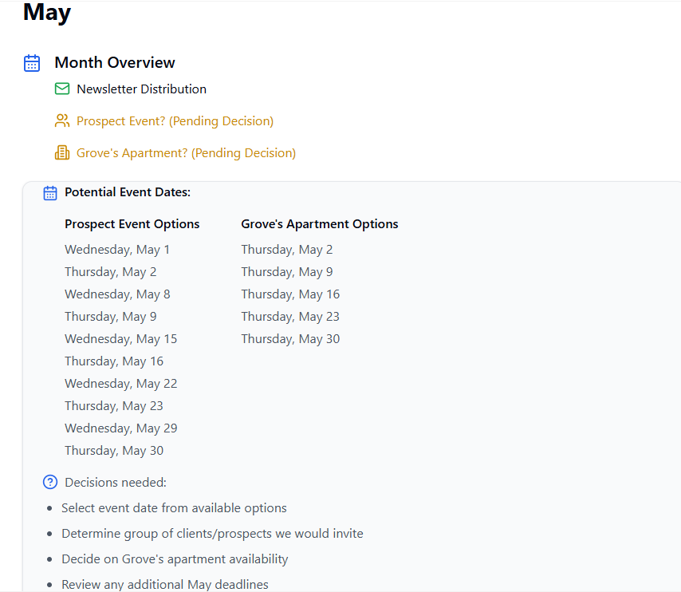

Slide 10
Next Meeting
March 12?
Tasks for next meeting:

